Slide 1



ML Dashboard Initial 4
View in Power BI
Last data refresh:
10/18/2016 2:39 PM UTC
Downloaded at:
2/21/2017 8:53 PM UTC

Slide 2

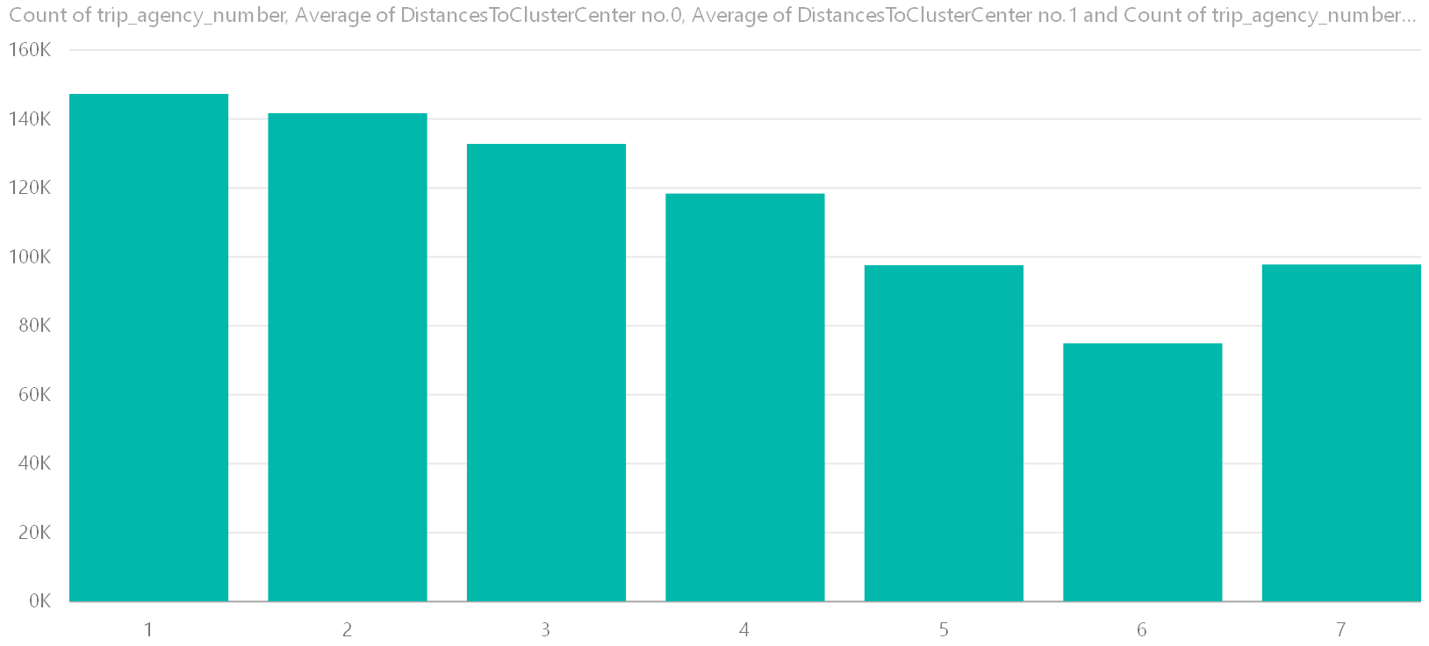
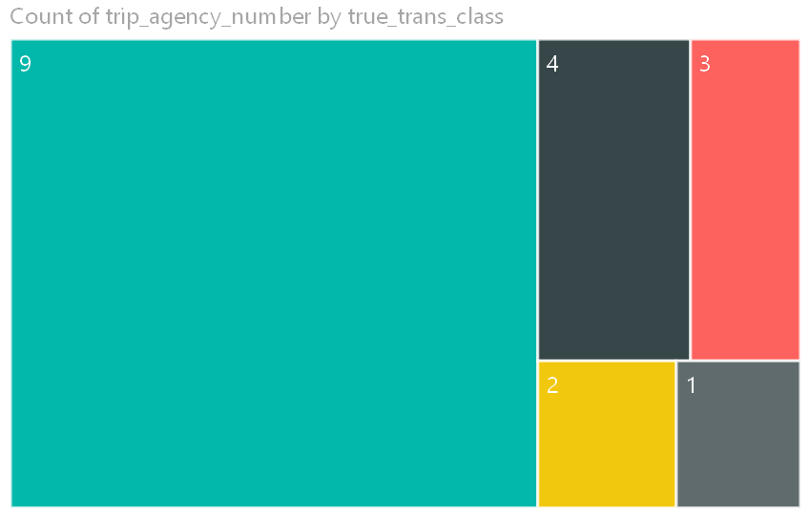
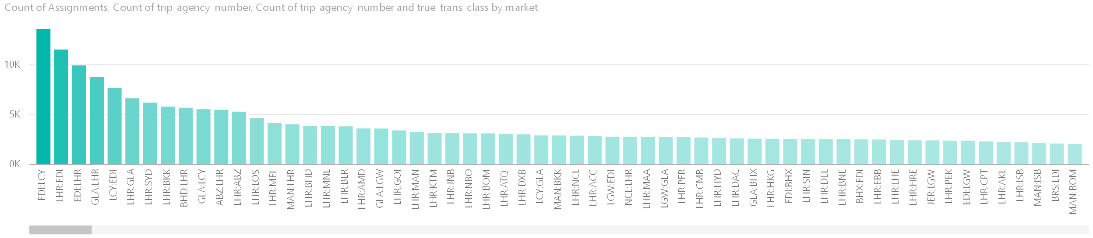

Slide 3
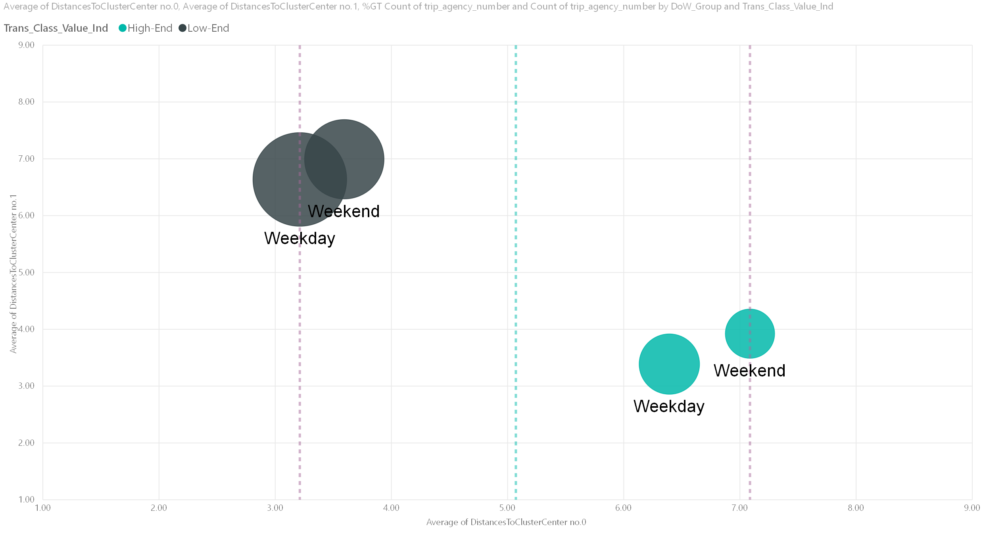

Slide 4
Breakdown by Locale Indicator and DoW
Airport Clusters
Custom visuals are currently not supported
More details
Custom visuals are currently not supported
More details
Cluster Changes Over Time (by DoW)
Custom visuals are currently not supported
More details

